Slide 1

Sprocket Central Pty Ltd
Data analytics approach
Mohammad Nehal, Jr. Data Scientist

Slide 2
Note: The data and information in this document is reflective of a hypothetical situation and client. This document is to be used for KPMG Virtual Internship purposes only.
Agenda
Introduction
Data Exploration
Model Development
Interpretation

Slide 3
Note: The data and information in this document is reflective of a hypothetical situation and client. This document is to be used for KPMG Virtual Internship purposes only.
Introduction
Indentifying and Recommending High Value Customers
Outline of the problem
Spyrocket Central is a company that specializes in high quality bike and accessories.
The marketing team is looking to boost sales.
To target 1000 new customer that will bring the highest value to the business.
Approach for Data Analysis
Bike Related Purchases for the last 3 years based on Gender.
Top industries contributing the maximum profit and bike related sales.
Wealth Segment by age category.
Number of Cars owned in each state.
Customer Classification.

Slide 4
Note: The data and information in this document is reflective of a hypothetical situation and client. This document is to be used for KPMG Virtual Internship purposes only.
Data Exploration
Data Quality Assessment
Key issue dealt with for the data quality issue:
 | Accuracy | Completeness | Consistency | Currency | Relevancy | Validity
Customer Demographic | DOB:Inaccurate Age: missing | Job Title: Blanks Customer ID: Incomplete | Gender: Inconsistent | Deceased Customer: Filtered out | Default column: Deleted
Customer Address |  | Customer ID : Incomplete | States: Inconsistent
Transactions | Profit: Missing | Customer ID: Incomplete Online Orders : Blanks Brands: Blanks |  |  |  | List Price: Format Product Sold Date: Format

Slide 5
Note: The data and information in this document is reflective of a hypothetical situation and client. This document is to be used for KPMG Virtual Internship purposes only.
Data Exploration
Top Job Industry Contributing to the Maximum Profit & Bike Related Purchases
The Top 3 Industry Sector Bringing in the Highest Profit are: Financial Services, Manufacturing and Health.
The people working in these top contributing industry prefer bike for commuting.

Slide 6
Note: The data and information in this document is reflective of a hypothetical situation and client. This document is to be used for KPMG Virtual Internship purposes only.
Data Exploration
Profit of Wealth Segment by Age Cluster
Overall, the Mass Customer segmentation makes the highest profit across the different age clusters.
Mass Customer Aged between 40-49 are likely to bring more profit for the company compared to other age clusters.
This also indicates a trend of buying power, as the buying power increases over time till 49 and then see’s a decline in buying power, thus leading to lower profits.

Slide 7
Note: The data and information in this document is reflective of a hypothetical situation and client. This document is to be used for KPMG Virtual Internship purposes only.
Data Exploration
Number of bikes owned in each state
NSW. QLD and VIC could be potential market opportunities for the company.
NSW has the highest potential as the number of people that own a bike is almost equal to the number of people who don’t own bikes which shows that there is opportunity to find value customers there.

Slide 8
Note: The data and information in this document is reflective of a hypothetical situation and client. This document is to be used for KPMG Virtual Internship purposes only.
Data Exploration
Bike Related Purchase Over The Last 3 Years Based On Gender
The data shows that on average, females have made more bike related purchases in the last 3 years compared to males.
On average, females have had 1% higher bike related purchases compared to men in the last 3 years.

Slide 9
Note: The data and information in this document is reflective of a hypothetical situation and client. This document is to be used for KPMG Virtual Internship purposes only.
Model Development
Customer Classification - Targeting High Value Customers
These are the high value customers that should be targeted from the new list:
Most of the high values customers will be female compared to male.
Working in the financial services, health and manufacturing industry sector,
Aged between 40-49
Who are currently living in NSW, VIC.

Slide 10
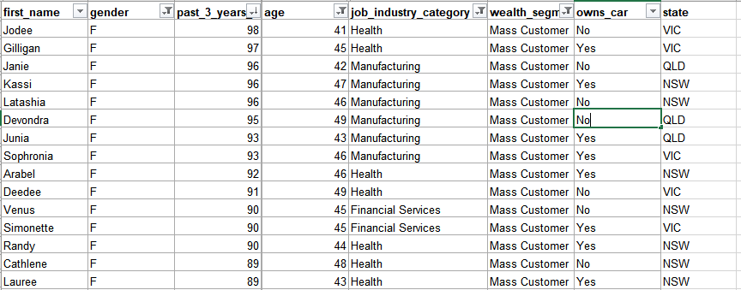
Note: The data and information in this document is reflective of a hypothetical situation and client. This document is to be used for KPMG Virtual Internship purposes only.
Interpretation
Summary Table for High Value Customers
Here is a snapshot of a few customers that will come under the high value customer classification :

Slide 11
Note: The data and information in this document is reflective of a hypothetical situation and client. This document is to be used for KPMG Virtual Internship purposes only.
Thank You

